Slide 1
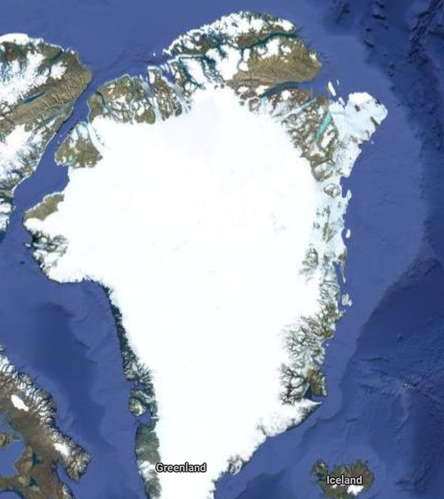
Greenland GLACIER ATLAS
Names: Brianna Chery and Abdullahi Ibrahim
Program in Computer Engineering
Advisor: Douglas Dow
Wentworth Institute of Technology
Boston, Massachusetts

Slide 2
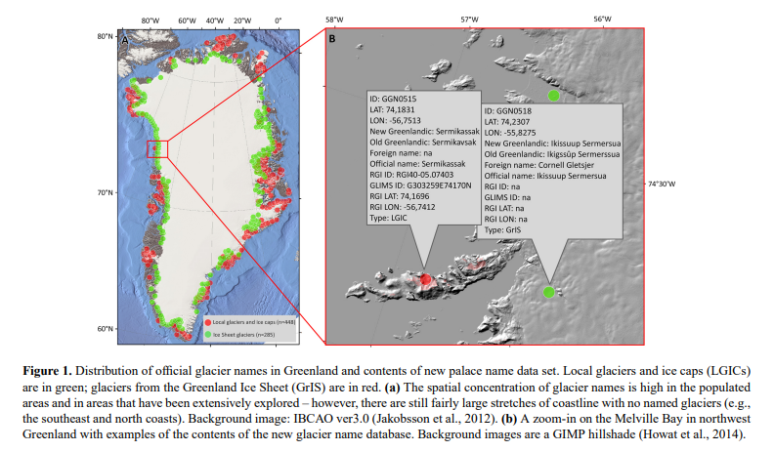
Initial Problem/Need
Place Names are a mix of Greenlandic, Danish and other foreign languages
Orthographies have changed over time
Efforts to name glaciers and record their locations have come with many challenges
Nunat Aqqinik Aalajangiisartut (NAA) and Danish Geodata Agency (GDA) created the database

Slide 3
Twila's Points
Investigated decadal information on the rate of glacier / ice sheet flow change fluctuating
Accounts for the increase of glacier discharge into large waters, sediment
There exists a potential link to past behavior that can prove to beneficial in accurately plotting glaciers and their tendencies.
Ultimately, these observations are key to having accurate readings in the change of glacier flow in due time

Slide 4
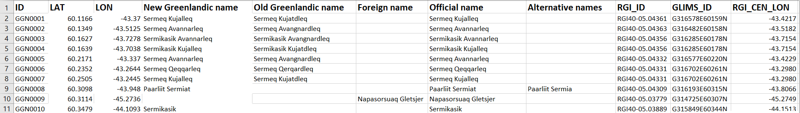
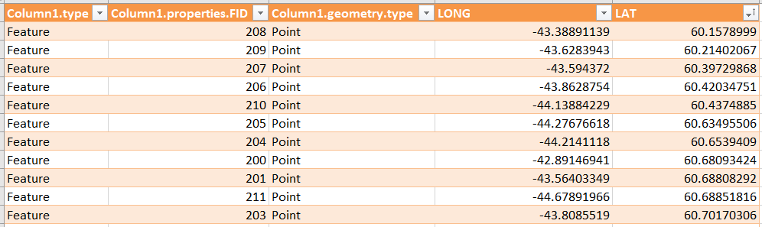
Data of Glaciers

Slide 5
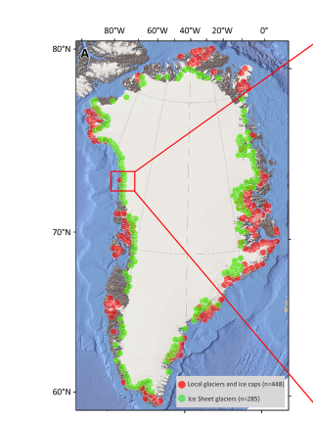
Problem to solve
Correctly match the coordinates with the Greenlandic Name that it is associated with
Create a user-friendly atlas that will allow users to navigate through each glaciers (with the name and coordinate associated with it)

Slide 6
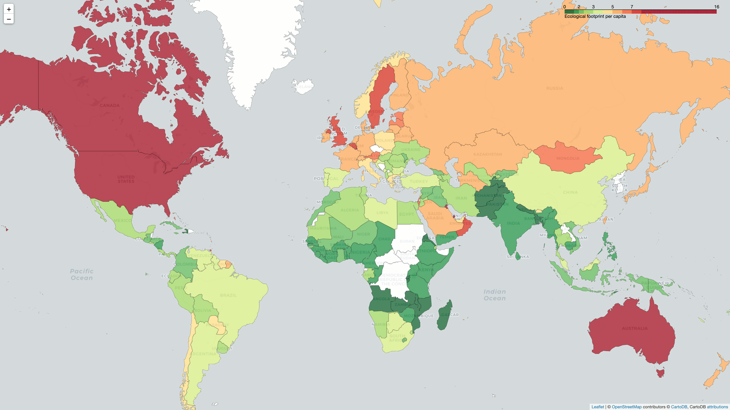
Method
Folium
Python folium library gives access to the mapping strengths of the Leaflet JavaScript library though a Python API
Allows to create geographic visualizations
Interactive
Can be share to a website
Notes:
https://realpython.com/python-folium-web-maps-from-data/

Slide 7
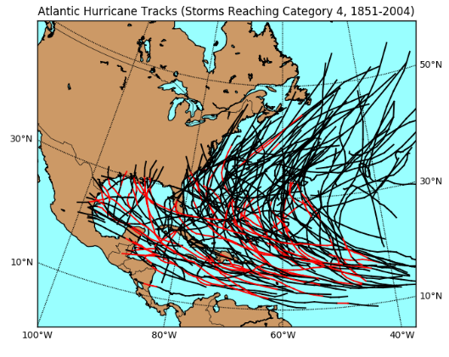
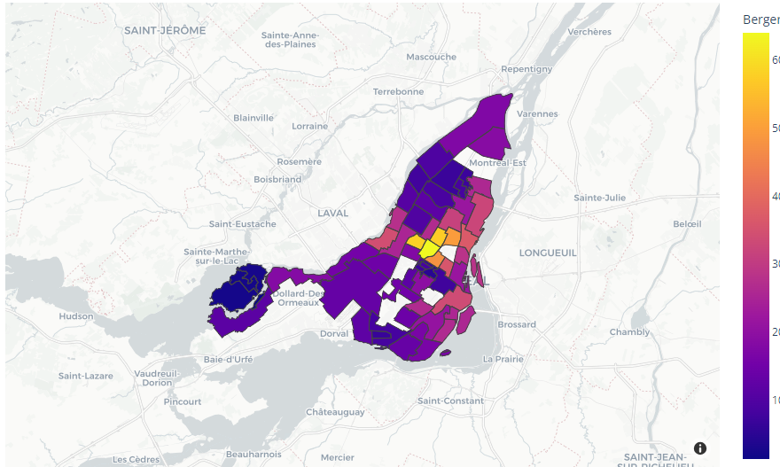
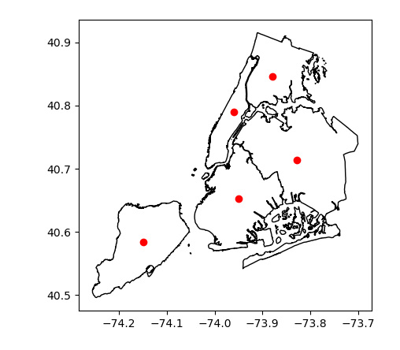
Alternatives
Matplotlib Plotly Geopandas:

Slide 8
More on Alternatives
Matplotlib: a plotting library with a list of functions to plot out data in the form of scatter plots, bar graphs, etc while geocoding on a map
Plotly: more interactive in the sense that you can pan onto the map or zoom in/out
Geopandas: a python addition to pandas and matplotlib that focuses on geospatial data. It can read, manipulate, and visualize geospatial data, including shapefiles and GeoJSON files, allowing the user to load and plot their maps.
Basemap: a matplotlib toolkit for plotting maps and creating geospatial visualizations. It provides a wide range of map projections and customization options.

Slide 9
Results

Slide 10
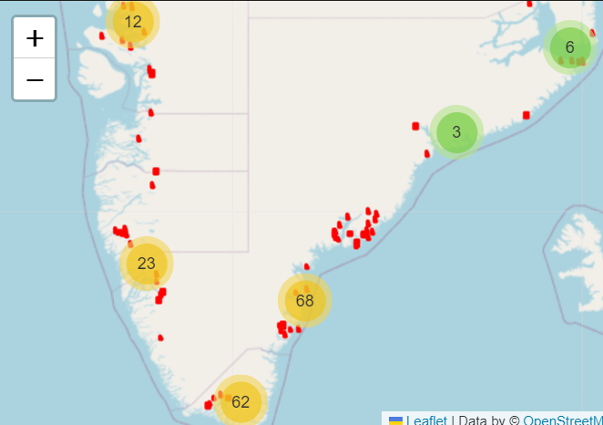
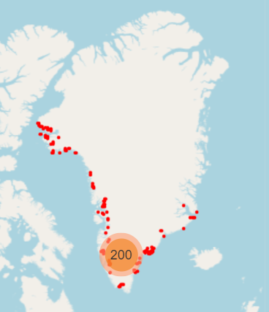
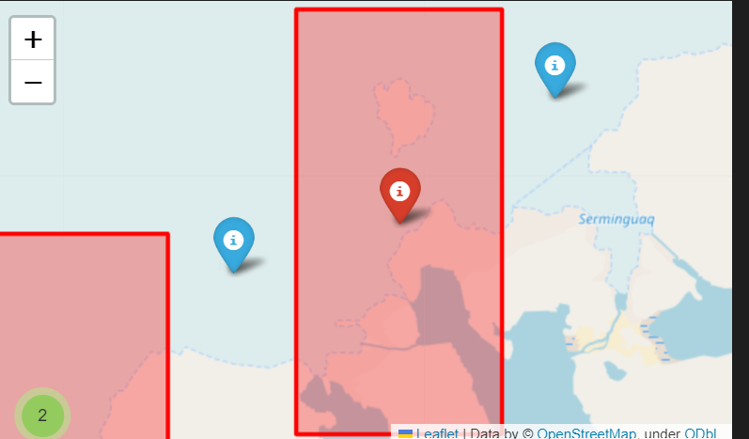
Design

Slide 11
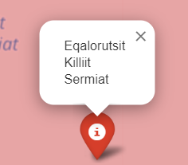
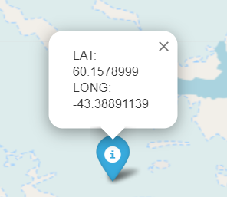
End Goal
Share it as a website
User-friendly
Easy to access the different glaciers and coordinates
Add any relevant information regarding each of the glaciers

Slide 12
Demo

Slide 13
References
[1]
T. A. Moon, A. S. Gardner, B. Csatho, I. Parmuzin, and M. A. Fahnestock, “Rapid Reconfiguration of the Greenland Ice Sheet Coastal Margin,” vol. 125, no. 11, p. e2020JF005585, 2020, doi: 10.1029/2020JF005585.
[2]
A. A. Bjørk, L. M. Kruse, and P. B. Michaelsen, “Brief communication: Getting Greenland’s glaciers right – a new data set of all official Greenlandic glacier names,” vol. 9, no. 6, pp. 2215–2218, 2015, doi: 10.5194/tc-9-2215-2015.
[3]
Deparkes, “Folium Marker Clusters,” deparkes, https://deparkes.co.uk/2016/06/24/folium-marker-clusters/.
[4]
M. Breuss, “Python folium: Create web maps from your data,” Real Python, https://realpython.com/python-folium-web-maps-from-data/ (accessed Jun. 13, 2023).

Slide 14
Questions?

